Slide 1
The Mentors & Enablers
Trainers & Management Consultants Training | HR & OD Consulting | Psychometrics & Diagnostics | Social Responsibility Endeavors
Your Partner for psychometric profiling & assessment solutions
LINKING ASPIRATIONS WITH RESULTS
RESPONSIVE
INSIGHTFUL
REMEDIAL
ETHICAL

Slide 2
The Mentors & Enablers
Trainers & Management Consultants Training | HR & OD Consulting | Psychometrics & Diagnostics | Social Responsibility Endeavors
Psychometric Assessments : Basics
Presented by :
Nanda Dave
Director, The Mentors & Enablers
Experts in
Psychometric Assessments
Competency Mapping & Assessments through End to end
Assessment / Development Centre (AC / DC),
Post assessment feedback, facilitating IDPs
Facilitating Competency Enhancement & Leadership Skills Building Training

Slide 3
The Mentors & Enablers
Trainers & Management Consultants Training | HR & OD Consulting | Psychometrics & Diagnostics | Social Responsibility Endeavors
Psychometric assessments are used by 80% of Fortune 500 companies and 75% of Times Top 100 Companies.

Slide 4
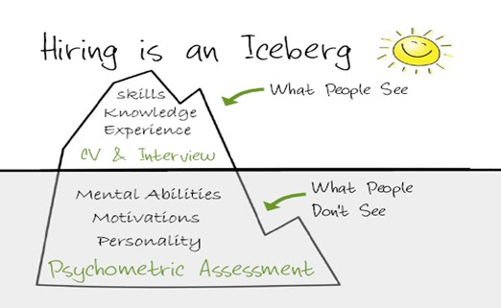
The Mentors & Enablers
Trainers & Management Consultants Training | HR & OD Consulting | Psychometrics & Diagnostics | Social Responsibility Endeavors
Why psychometric tests are preferred during hiring ?
A psychometric test aims to provide measurable, objective data that can provide a better all-round view of a candidate’s suitability.
It is a scientific method to measure candidates’ capabilities and behavioural style.

Slide 5
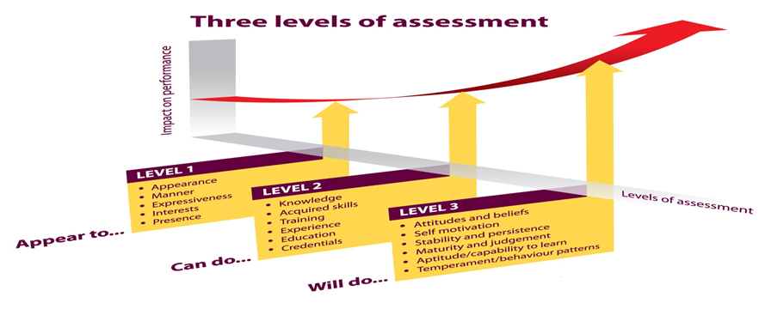
The Mentors & Enablers
Trainers & Management Consultants Training | HR & OD Consulting | Psychometrics & Diagnostics | Social Responsibility Endeavors
There’s some debate over the value of psychometric testing, but those who use it believe that it can give a more objective overview of a candidate’s character, strengths, weaknesses and working style.
Typically, a psychometric test will never be used in isolation, but as one component of a wider, integrated evaluation strategy.

Slide 6
The Mentors & Enablers
Trainers & Management Consultants Training | HR & OD Consulting | Psychometrics & Diagnostics | Social Responsibility Endeavors
Companies use psychometric assessment for ...
Objectivity : Candidates are able to demonstrate talents that may not be evident in their CV or work profile narration.
Validity : Facing and inconsistencies are ruled out. A candidate might be a star in the interview, but if their assessment reveals they don’t work well in a team, they may not be the best fit for the job.
Cost Effectiveness : Interviewing, training, and then losing employees takes a massive toll on a company’s budget. Psychometric assessments help minimise costs by improving the chances of an ideal fit between the candidate and the job specification

Slide 7
The Mentors & Enablers
Trainers & Management Consultants Training | HR & OD Consulting | Psychometrics & Diagnostics | Social Responsibility Endeavors
Psychometric solutions work best when they are individually tailored to your situation.
We are experts in customizing assessment solutions to suit your specific needs.
For more details,
Call on 09824509399
Write to us : email : nandadave@thementorsd-trainers.com
Visit us : www.thementors-trainers.com

Slide 8
The Mentors & Enablers
Trainers & Management Consultants Training | HR & OD Consulting | Psychometrics & Diagnostics | Social Responsibility Endeavors
Assessment & Profiling Solutions for Various Management Decision Making
Assessments & Profiling can be solution for you to ….
Weed out candidates with the wrong attitudes or poor work ethics
Predict team compatibility, conflict management style, approaches to decision making & problem solving so as to help him / her adjust better to the environment
Understand individual stressors that impact his / her productivity
Profiling applications can be insightful and remedial.
You will be happy to know that we can support you in the business challenges in the above areas through our assessment & profiling services…

Slide 9
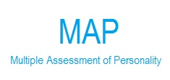
The Mentors & Enablers
Trainers & Management Consultants Training | HR & OD Consulting | Psychometrics & Diagnostics | Social Responsibility Endeavors
Sample Psychometric Assessments At Your Service …
This is an indicative list only.
We customize our offering as per your assessment needs.

Slide 10
The Mentors & Enablers
Trainers & Management Consultants Training | HR & OD Consulting | Psychometrics & Diagnostics | Social Responsibility Endeavors
Extended DISC
Offers – Individuals, work pairs, teams & organizations profiles.
Used for – Higher level management recruitment / potential assessment / succession planning / developmental gap analysis / leadership style profiling / team compatibility scanning etc…
Process – Online (Available in English, Hindi, Gujarati Marathi & Kannada) Takes just about 12-15 minutes at max – reports highlight natural self vs. adjusted self concerns, highlights environmental impacts on individual’s adaptations.
Additionally … Extended DISC is presently considered to be amongst the top 3 psychometric tools in the world. Originated in Finland, Europe after 20+ years of research, it operates in 60+ countries of the world. We are Strategic Business Partner with Extended DISC India engaged in ethical promotion of assessment system and part of international practitioners network. We are authorised to conduct Level 1 certification workshop – CEDA - Certified Extended DISC Administrator by Extended DISC India & Extended DISC International
MBTI - Myers & Brigs Type Indicator
Offers - Individual reports – team & organizational diagnostic reports also available.
Used for – Management Position, Mainly used for developmental purpose, not for assessments and rejection
Process – Online / offline
Additional information – certified for Level 1 & 2, proficient with advance applications of MBTI for OD

Slide 11
The Mentors & Enablers
Trainers & Management Consultants Training | HR & OD Consulting | Psychometrics & Diagnostics | Social Responsibility Endeavors
FIRO – B : B is a very popular trait test promoted by Consulting Psychological Press (CPP) – in usage since 1958.
Offers – Insights into leadership/ managerial styles / interpersonal orientation of an individual
Used for – Mid level Management position for recruitment / TNA/ Leadership skills building / teambuilding etc.
Process – offline (available in English only)
WPS : Work Personality Scale
Indicates the scale of personal tendencies that an individual reflects . Helps measure individual’s personality complex, so as to place /utilize in business & industry
Offers – Insights into individual’s general adjustment pattern, his/her ability to adjust & adopt to people and situations. Offers critical insights with respect to mental health, maturity, morality, learning ability, sincerity etc.
Used for – Operator, clerical staff, sales/ retail sales representatives (people at the base of sales organization)
Excellent tool for blue collared workforce in manufacturing, service, retail, sales organization
Process - offline
16 Personality Factors :
Popular trait test – used extensively for recruitment / fitment assessment.
Offers – Gives an insight on 16 personality traits of an individual like Emotional Stability, Vigilance, Dominance, Reasoning and so on.
Used for – Office administrative staff, operative staff .
Process - off line

Slide 12
The Mentors & Enablers
Trainers & Management Consultants Training | HR & OD Consulting | Psychometrics & Diagnostics | Social Responsibility Endeavors
MAP - Multiple Assessment
Offers – Indian adaptation of 16pf, offers 20 dimensions suiting to Indian culture context. Mainly used for recruitment and development
Used for – Clinical / Graduate Engineer Trainees, Management Trainees, Junior management positions
Process - off line.
Sales Role Fitness
Offers – fitment in sales role / likely gaps in performing in the sales role / productive sales performance. Predicts success in sales role by measuring Sales Aptitude. Effectively predicts major concerns that need attention in the present sales role.
Used for – Sales professionals like sales representatives, Medical representatives, Front end sales staff, retail sales force etc. An excellent way to ensure that sales recruitment / potential assessment is accurate and return on sales expenses is guaranteed with right selection / placement
Process - off line
FLAG – 16
Offers – Offers quick dependable insights during assessment of talents for higher roles internally eg. Appointing first time executives / team leaders
Used for - recruitment of Engineers, fresh graduates, fresh professionals getting in the world of work to gauge cultural integration abilities of the individual.
Process – Offline

Slide 13
The Mentors & Enablers
Trainers & Management Consultants Training | HR & OD Consulting | Psychometrics & Diagnostics | Social Responsibility Endeavors
FinxS Reasoning Analysis for Management / Critical People / Critical position holder’s Assessment :
A set of psychological tests designed to measure the individual’s reasoning skills
Typically used for measuring a person’s future development potential , internal transfers & recruitment
Excellent interpretation and information about person’s ability for critical thinking, creative problem solving , collecting, analysing and synthesising abilities for decision making
Assessment of Multiple Aptitudes & IQ testing for staff / operative group / non management position holders
Differential aptitudes – numerical, verbal, spatial, mechanical, clerical, psychomotor, closure etc. are important in operating roles in manufacturing set up
The aptitude tests define proficiency for each skill set and gaps that need to be bridged. These multiple aptitudes ensure intake of skilled and potentially groom able employees. Hence help avoid all frustrations for discovering incompetence and forced exit with in a year’s time
Paper pencil version available. Time bound tests ensure proficiency of high order
We are trained and have demonstrated high level of proficiency in interpretation and advise Multiple aptitudes & IQ testing

Slide 14
The Mentors & Enablers
Trainers & Management Consultants Training | HR & OD Consulting | Psychometrics & Diagnostics | Social Responsibility Endeavors
We are assessment and profiling experts, having more than a decade's track
record in assessments and profiling solutions. We have …
Profiled more than 3000 candidates for pre hiring / recruitment fitment ‐ Have partnered with Green field companies for profiling solutions at senior, middle and junior management cadre, profiling for role fitment for cross section of industries and functions encompassing sales, operations, manufacturing, customer services and after sales
Profiled more than 2000 operative level candidates as pre recruitment fitment scan (for green field projects) / regularisation of contract workers. while taking them on company's roll, served clients with selecting shop floor teammates with positive behavioural orientation and weeding out prospects with tendencies like socio pathology, low mental health, low
maturity, learning disability / low IQ etc.
Profiled more than 2500 professionals through assessment /development center
Facilitated Sales Fitness Scan for recruitment / promotion / performance gap & similar HR decisions in sales function
Provided Assessment solutions for Leadership profiling, identifying HiPo and building talent ladder
Offered Fitment scan at entry level for Graduate Engineer Trainees / Management Trainees enabling effective utilisation of budding talents, placements suiting their creative abilities, leading to their retention &
enhanced productivity.
Our endeavour is to enable our clients making more effective HR decisions – Recruitment, Profiling, Leadership Assessment, Potential Assessment, Developmental Gaps Analysis etc. using these psychometric tools.
ETHICAL
RESPONSIVE
INSIGHTFUL
REMEDIAL

